Slide 1
Section 7.1 and 7.2
Scaled Diagrams and Scale Factors
© Copyright all rights reserved to Homework depot: www.BCMath.ca

Slide 2
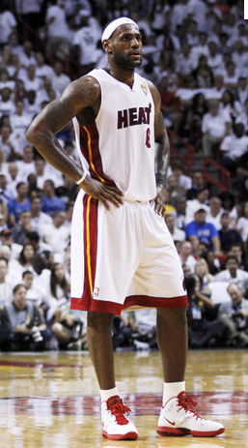
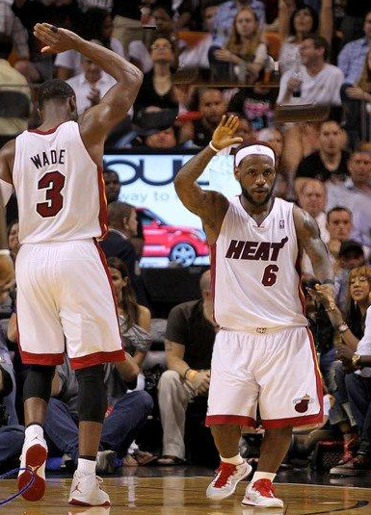
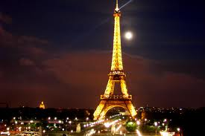
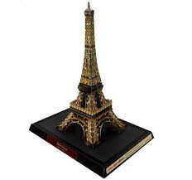
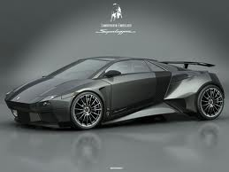
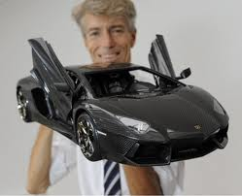
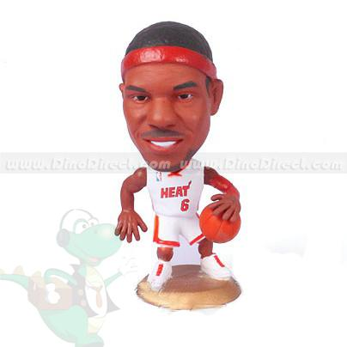
What are Scaled Diagrams?
A scaled diagram or scaled object is a model or replica of an object
It is usually an enlargement or reduction of actual object
Scaled diagrams/objects are found in toys, construction, and pictures
Scaled objects should have the same proportions as the actual object
Actual LeBron James (2cm)
Real Eiffel Tower 324m high
Real Ferrari 4.7m long
Toy Eiffl Tower 15 cm long
Toy Ferrari 30cm long
Toy LeBron James (8cm)
NOT to SCALE!!

Slide 3
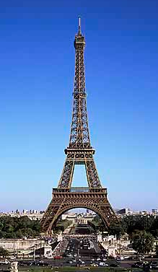
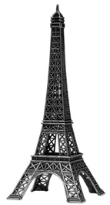
Properties of Scaled Diagrams
All corresponding parts must have the same proportions
The proportion is based on the “scaled factor” – a number that tells you how many times bigger or smaller is the scaled object compared to the actual object
Note: Make sure they are in the same units!!!
© Copyright all rights reserved to Homework depot: www.BCMath.ca

Slide 4
Converting KM, Meters, CM, MM
Here’s a chart to show the equivalence in lengths of different units!

Slide 5
Practice: Convert the length to the units desired
i) 35km = _________ meters
ii) 15km = _________ cm
iii) 201m = _________ mm
iv) 910cm = _________ meters
v) 65,000cm = _________ km
vi) 870,000mm = _________ meters
vii) 55m = _________ km
To find the scaled factor of a scaled objects, they must have the same units first!!
viii) 18km = _________ mm

Slide 6
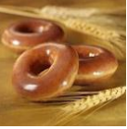
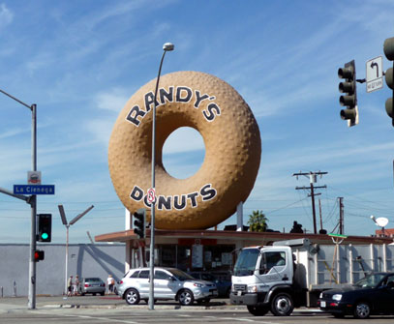
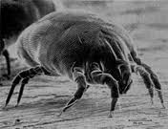
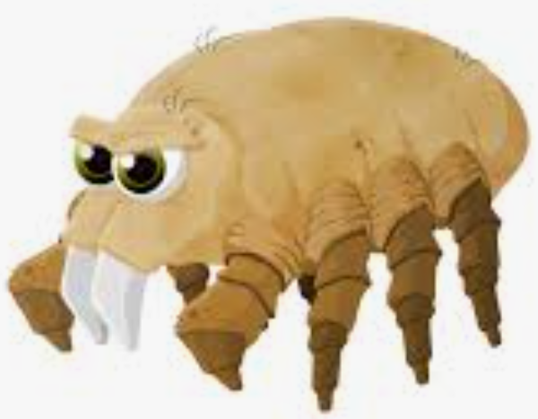
Ex# Find the scaled factor for each of the following:
The body of a house
dust mite is just visible
against a dark back-
ground in normal light.
A typical house dust mite
measures 0.4 millimetres
© Copyright all rights reserved to Homework depot: www.BCMath.ca

Slide 7
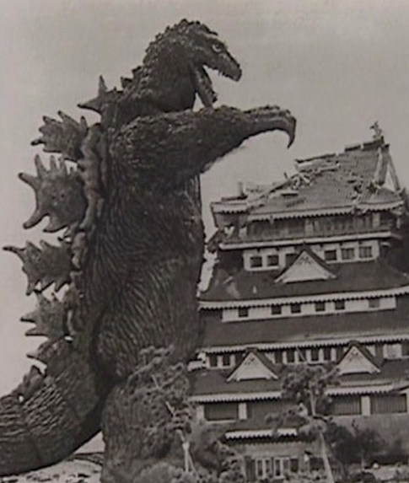
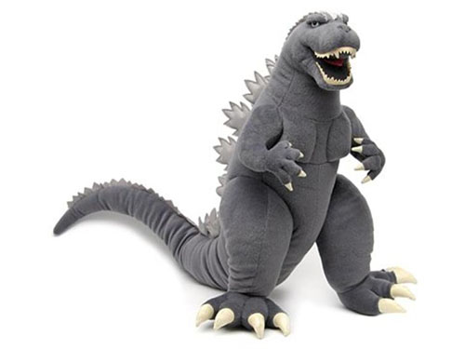
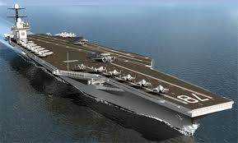
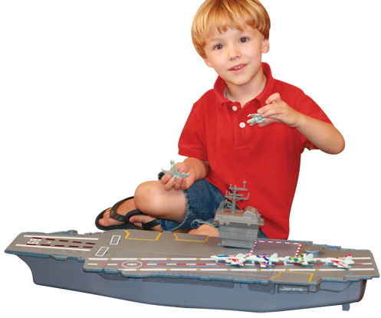
Practice: Find the scaled factor for the following:
© Copyright all rights reserved to Homework depot: www.BCMath.ca

Slide 8
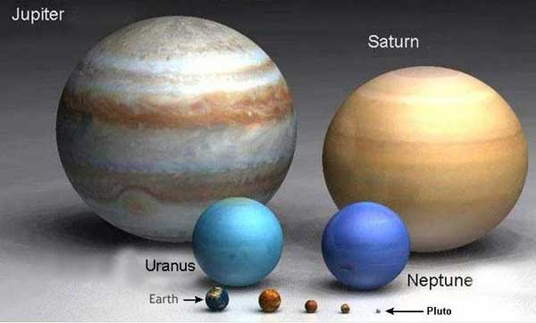
Practice: If the radius of the earth is 6378km and the radius of Jupiter is 71492km, what is the scaled factor and the size of the earth model if the radius of the Jupiter model is 30cm?
© Copyright all rights reserved to Homework depot: www.BCMath.ca

Slide 9
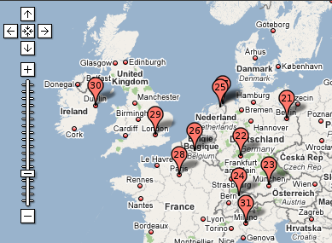
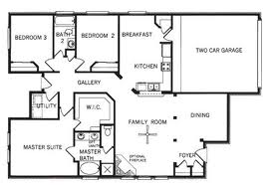
Using Scaled Factors (Enlargements & Reductions)
A reduction will reduce the size of an object making it smaller
Reductions occur in maps, floor plans, and miniatures
Reductions occur when the scaled factor is between 0 and 1
Scaled factors don’t show units, they only tell you how many times smaller or bigger something is compared to actual object
ie: A scaled factor of means that the scaled diagram is 10 times smaller than the actual image → “REDUCTION”
Ie: a scaled factor of “10” means that the scaled diagram is 10 times larger than the actual image → “ENLARGEMENT”
SF = 0.0000001
SF = 0.001
© Copyright all rights reserved to Homework depot: www.BCMath.ca

Slide 10
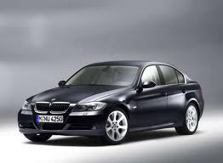
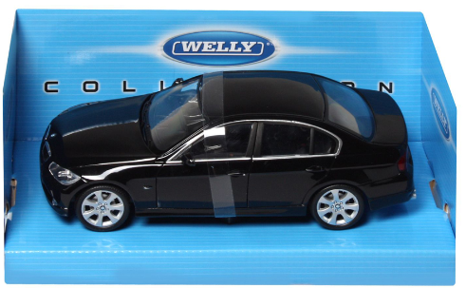
Ex: The following is a picture of a BMW with a scaled factor of 1/20. What is the actual length of the car?
© Copyright all rights reserved to Homework depot: www.BCMath.ca

Slide 11
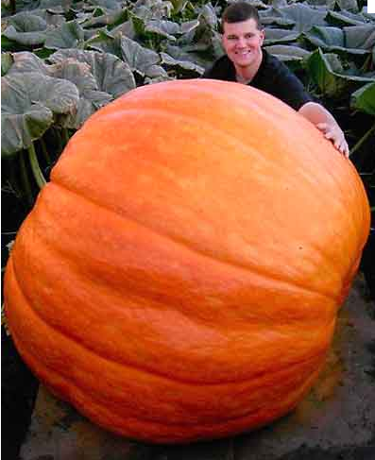

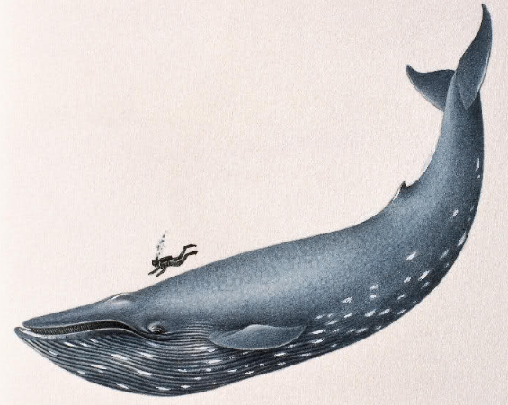
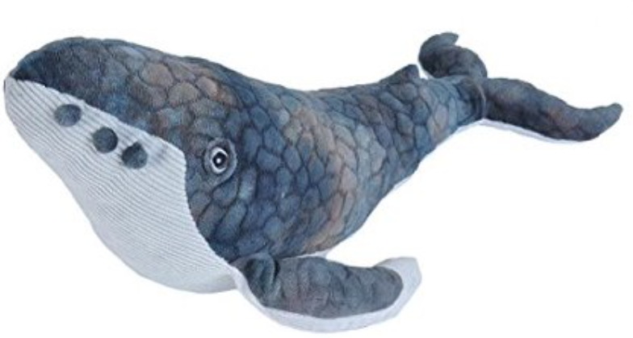
Practice: Given each scaled factor, determine the length of the scaled diagram:
Actual Object:
Scaled Factor
Scaled Object:
© Copyright all rights reserved to Homework depot: www.BCMath.ca

Slide 12
Ex: If the radius of the earth is 6378km and the radius of Jupiter is 71492km, what is the scaled factor and the size of the earth model if the radius of the Jupiter model is 30cm?
© Copyright all rights reserved to Homework depot: www.BCMath.ca

Slide 13
Ex: The following object is to be increased by a scaled factor of 3.5. Draw the scaled diagram with the grid provided
© Copyright all rights reserved to Homework depot: www.BCMath.ca

Slide 14

Miniature World
© Copyright all rights reserved to Homework depot: www.BCMath.ca

